Slide 1

Submitted by:-
Ashutosh Mishra
SMS SPAM CLASSIFIER

Slide 2




Introduction
Top Classification Model
Spam or Ham ?
Which NLP Technique?
Background and Approach

Slide 3




Introduction -
Our goal is to build a prototype of SMS Spam Classifier which can be used to classify ham and spam texts so that it can be controlled and restricted from spreading cybercrime and cyberbullying.
Libraries Explored
Motivation Behind
NLP (nltk), Sklearn
Hyper Tuning Method
CV Score
Predictive Modelling and Classification Model, etc.
To understand the working of NLP techniques like BOW, CBOW, TF-IDF, Ngram, Stopwords, Tokenization, Lemmatization, Stemming and how the text preprocessing could be helpful to find out the vector representation of each words, corpus and its vocabulary.
Objective
NLP Techniques
Project comprises of seven different test cases where the objective was to train and test for accuracy score and different classification reports using CV Score to check the accuracy of the different algorithms model
Bag of Words (BOW)
Term Frequency Inverse Document Frequency (TF-IDF)
Word2Vec

Slide 4
Background and Approach -
Classification Models
Model
NLP
There has been a remarkable increase in the cases of cybercrime as spammer has really been advanced with their technologies that’s why they are easily looting the people and making them suffer mentally without any much efforts. This can take a toll on anyone and affect them mentally leading to depression, mental illness, self-hatred and even suicidal thoughts. Our goal is to build a SMS Spam Classifier which can be used to classify spam and ham texts so that it can be controlled and restricted from spreading cybercrime.
NLP
ROC AUC Curve
CV Score
Random Forest Classifier
Classification Modelling
Hyper Tuning Method
Grid Search CV

Slide 5
Data Preprocessing Done
Firstly, when I did go through our corpus dataset then I founded that each of the document consists of some special characters in it with numbers and upper-lower case alphabets hence I applied NLP techniques like regular expressions and English stopwords to clean each sentences of our corpus into lower and upper case alphabets only. Then I applied tokenization and stemming to get words that might not be that meaningful and at the end our corpus got free from English stopwords (is, am, he, she, from, for, at, there, it and etcetera).

Slide 6
Data Preprocessing Done
After data cleaning part done I’ve applied Bag of Words and TF-IDF techniques to convert the words into vector and then created Vocabulary for both the model. Since, our target class was imbalanced eventually hence I did balanced it with the help of SMOTE technique and once the class got balanced I’ve separated my feature variable and target variable for the model building and then with the help of Machine Learning algorithms I’ve trained different model and later did testing of each model with respect to some valuable parameter like Cross Validation Score, ROC AUC Score, F1-Score to find out the best model in predicting our target variable.

Slide 7
Bag of Words (BOW)
Bow is a text preprocessing technique which is use to convert the words into vector form. The word CountVectorizer represents BOW. I’ve taken max_features as 2500 which indicate that there are 2500 features got created and binary =True indicate that our target variable has only binary classes as 0 and 1; ngram_range= (2,2) will create features joining only two words all-together

Slide 8
Term Frequency Inverse Document Frequency (TF-IDF)
TF-IDF is also a text preprocessing technique which is use to convert the words into vector form. With the help of this method we give more weightage to those words having rare presence in the sentences. We apply term frequency in rare words and Inverse Document Frequency in most use words of corpus.

Slide 9
Term Frequency Inverse Document Frequency (TF-IDF)
The word TfidfVectorizer represents TF-IDF. I’ve taken max_features as 2500 which indicate that there are 2500 features created and in the last I’ve selected ngram_range= (1,2) and this will create features of one and two words all-together.

Slide 10
Term Frequency (TF) = (No. of the times that particular word in the sentence / No. of the words in that sentence)
Inverse Document Frequency (IDF) = log (Total no. of sentences / No. of sentences containing that word)

Slide 11
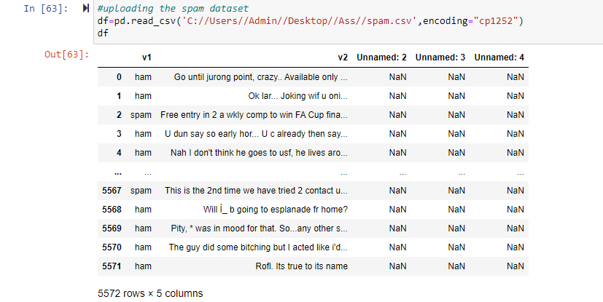
Data Source Visualization-

Slide 12
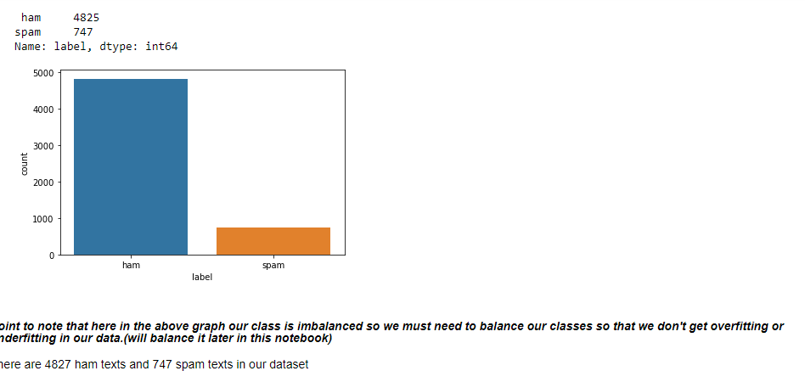
Data Source Visualization-

Slide 13
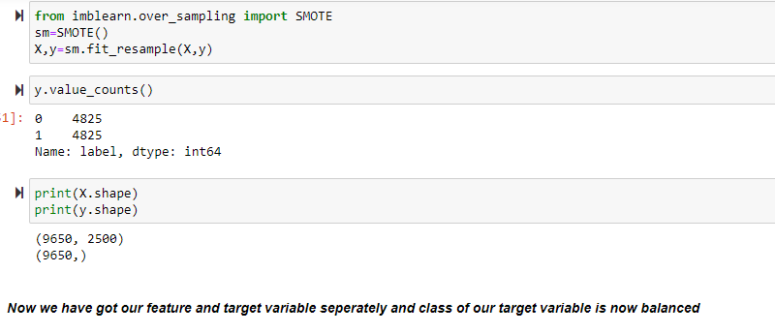
Data Source Visualization-

Slide 14
Top Classification Models
Classification Models (TF-IDF) | Testing Accuracy (in %)
Gaussian NB | 92
Gradient Boosting Classifier | 96
K Neighbors Classifier | 62
Random Forest Classifier | 99
Decision Tree Classifier | 96
Ada Boost Classifier | 97
Logistic Regression | 96

Slide 15
Challenges Faced
One of the key challenges was like applying the Word2Vec NLP technique as I was getting an error while training the model and the error was "only length-1 arrays can be converted to Python scalars". However, I’ve founded some really interesting similar words concepts, vocabulary and their vector representations as well.

Slide 16
Conclusion -
Classification Models (BOW) | Training Accuracy (in %) | Testing Accuracy (in %) | ROC AUC Score (in %) | F1-Score (in %) | Ranking
Logistic Regression | 77 | 77 | 0.76 | 77 | 4
Gaussian NB | 82 | 80 | 0.80 | 80 | 2
Gradient Boosting Classifier | 73 | 74 | 0.73 | 74 | 6
K Neighbors Classifier | 78 | 76 | 0.75 | 76 | 5
Random Forest Classifier | 86 | 81 | 0.81 | 81 | 1
Decision Tree Classifier | 86 | 78 | 0.79 | 78 | 3
Ada Boost Classifier | 72 | 72 | 0.72 | 73 | 7

Slide 17
Conclusion -
As we can see that Random forest classifier is best algorithm among all as it gives highest score as compare to others and also the CV score of this algorithm is equal to its testing accuracy which is highest among other. ROC AUC score of this algorithm is 0.81 which is highest among all and it indicates that out of 100 times, 81 times our model is predicting right class. Hence RFC model works well while predicting the target variable. Now let's find out the Model accuracy with the help of TF-IDF model and check whether our model accuracy would change or not...Lets find out the same.

Slide 18
Conclusion -
Classification Models (TF-IDF) | Training Accuracy (in %) | Testing Accuracy (in %) | ROC AUC Score (in %) | F1-Score (in %) | Ranking
Logistic Regression | 96 | 96 | 0.96 | 97 | 4
Gaussian NB | 91 | 92 | 0.92 | 92 | 6
Gradient Boosting Classifier | 96 | 96 | 0.96 | 96 | 5
K Neighbors Classifier | 100 | 62 | 0.63 | 62 | 7
Random Forest Classifier | 100 | 99 | 0.99 | 99 | 1
Decision Tree Classifier | 100 | 96 | 0.96 | 96 | 2
Ada Boost Classifier | 97 | 97 | 0.97 | 97 | 3

Slide 19
Conclusion -
As we can see that after applying the TF-IDF model our model's accuracy got increased by 15-25% which is really a great achievement in predicting the text spam detections. Random Forest Classifier is the best model for achieving the same having almost 100% accuracy across all the parameters and that indicates our model is predicting, spam as spam and ham as ham, 100 out of 100 times.

Slide 20


Thank You !
Ashutosh Mishra
ashutoshmishra11@outlook.com

